Slide 1
An illustration of Collider Bias in housing research
Centering the Public Interest in Integrated Administrative Data Analytics
Module 4 of 5
Public Interest Technology University Network Year 6 Challenge
January 2026

Slide 2
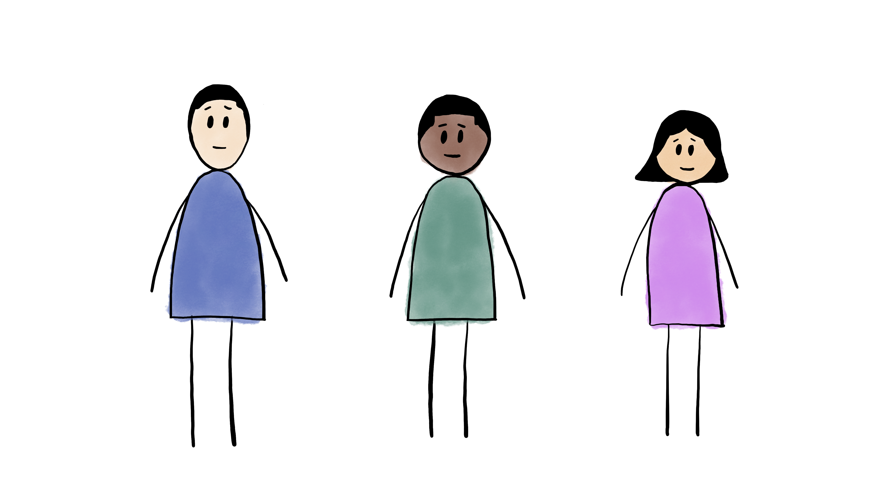
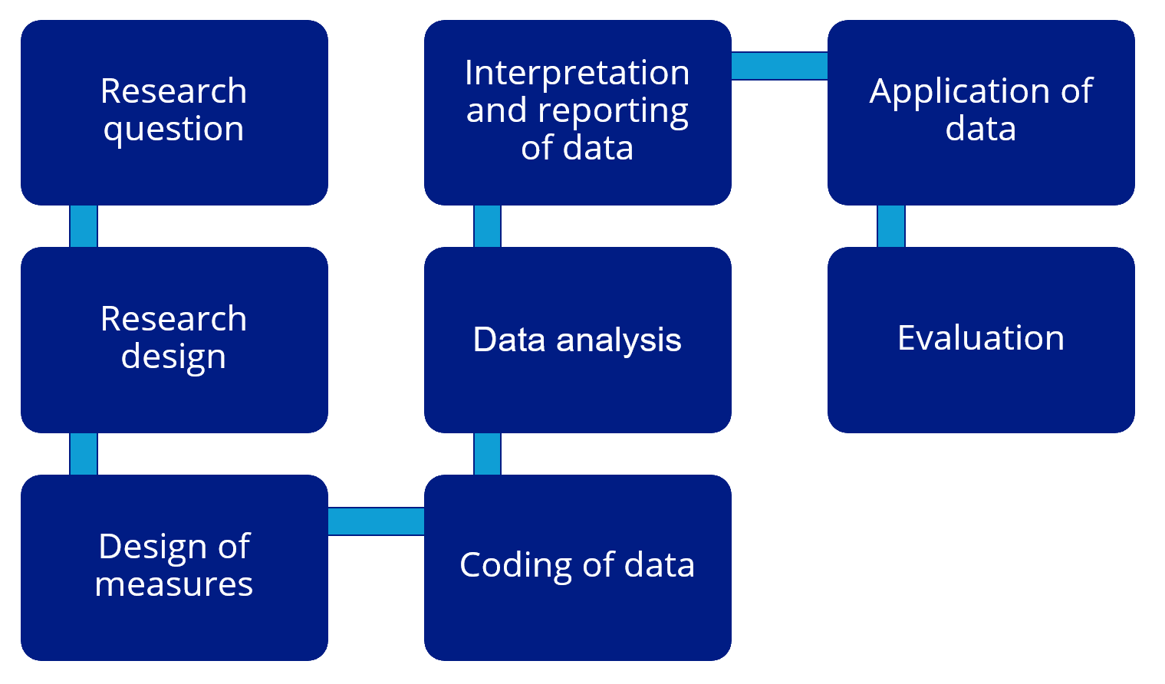


Module 3
An illustration of Label Bias in Homelessness
Data Analytics
Module 5
Recommendations to address constraints and bias in Integrated Data Analytics
2 2
Module 1
FAIR2: A framework for integrating community knowledge in data analytics and addressing discrimination bias
Module 4
An illustration of
Collider Bias in
housing research
Module 2
Demographic Data in Integrated Data Systems: Seeking Experiential Knowledge to Inform Race and Gender Data

Slide 3
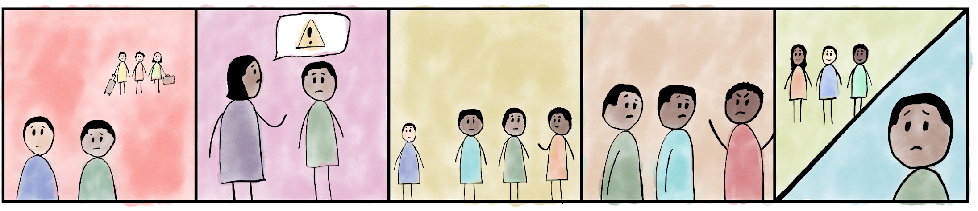
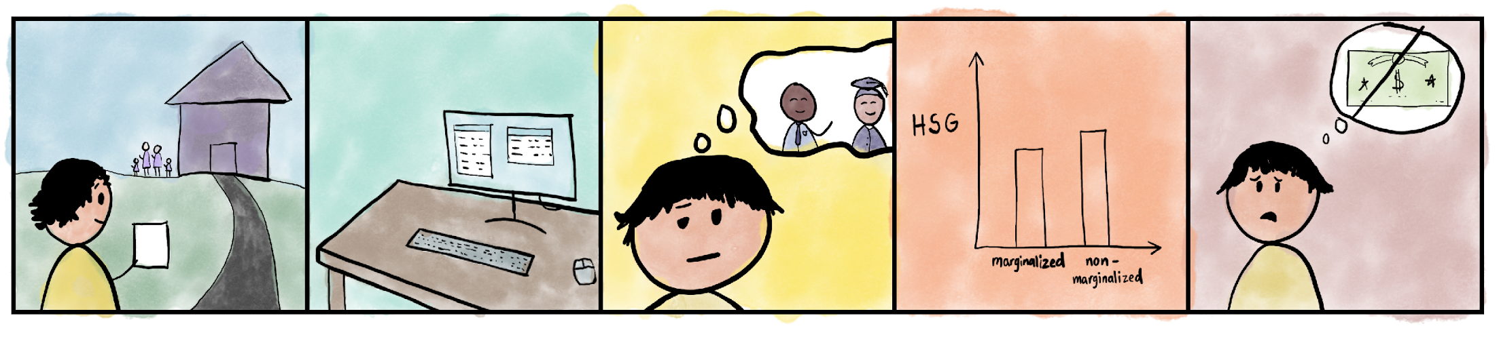
Amari and Liam have grown up together. Over the years, they’ve seen a lot of families move to more affluent areas. For Amari, his mom has had to work very hard for all they have and doesn’t have extra cash. For Liam, his parents have had to spend a lot of money on healthcare bills for his dad’s chronic health conditions. Neither Amari’s nor Liam’s families can afford to move.
As many of the White families have moved out, the neighborhood is now primarily Black except for families like Liam’s. Amari’s mom has given him many talks about growing up as a Black boy, and she’s always careful about where she allows Amari to go.
This type of awareness is normal for Amari. In fact, many of his friends at school have also been given talks about growing up Black in this world. Liam has struggled with his own family problems.
Although for different reasons, Amari and Liam have had bad experiences in school. Resources are scarce, teachers are overworked, and students are now more aware of how they are misperceived by society.
Amari and Liam are struggling with their grades. Although they are friends, neither feels that the other will understand the weight they carry inside.
Harper is a community practice social worker who works with families in Amari and Liam’s neighborhood. She’s heard about the experiences of discrimination these families encounter and wonders how it affects academic performance for the kids.
Harper decides to use marginalization based on race as an indicator of discrimination. She pulls high school graduation rates from school data and race from family data from the city’s income assistance program.
She’s hoping to see how discrimination impacts high school graduation rates so she can apply for funding for a peer mentor program. This program matches students in the neighborhood with students in college who have shared identities.
However, when Harper looks at the data, she sees that among kids in Amari and Liam’s neighborhood, marginalization based on race barely impacts graduation rates and is not statistically significant!
Harper concluded, “Well, this data won’t be helpful in applying for that grant…”

Slide 4
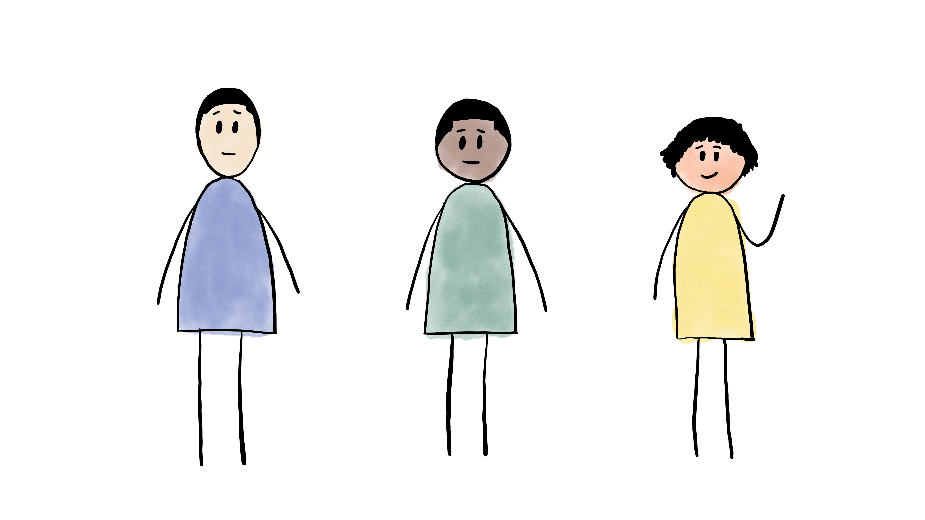
Amari and Liam’s story shows us that there are multiple reasons why people may end up in a particular population, like a neighborhood. Structural discrimination has limited opportunities for families like Amari’s across generations. Liam’s family experienced chronic health issues that took time, money, and resources. As such, neither Amari’s nor Liam’s families can afford to move to a neighborhood with more opportunities.
When looking within a particular population, it’s important to understand what factors contribute to people being in that population.
Remember what Harper saw when looking only at Amari and Liam’s neighborhood: No effect of discrimination on the likelihood of high school graduation.
What factors may contribute to Harper seeing little difference in high school graduation rates by race (-based marginalization) in Amari and Liam’s neighborhood?

Slide 5
Introduction
You’re a social worker in community practice, who primarily works with families in low-income neighborhoods. You notice that marginalization is one of the challenges these families and their neighborhoods face. You wonder how marginalization affects children as they are growing up and preparing to go out on their own. You ask yourself:
What are the effects of marginalization on the likelihood of high school graduation?
You received school data for these low-income neighborhoods including whether students graduate high school.
Let’s think about how you’re going to use that data to answer your questions…

Slide 6
Collider Bias in Research
What are the effects of marginalization on the likelihood of high school graduation?
You only have data on the individuals in the neighborhoods where you work
Given the history of discrimination in housing policy, you know that marginalization also influences neighborhood access
Let’s start by building a very simple graphical model:
Marginalization
This is a Directed Acyclic Graph or DAG, a powerful visual representation of model assumptions that can help us identify biases (Pearl & Mackenzie, 2018).
Low-income Neighborhood
High School Graduation

Slide 7
Collider Bias in Research
A more realistic graph recognizes that factors other than discrimination may lead to living in low-income and low-resourced neighborhoods
We’ll refer to these factors as vulnerabilities
Vulnerabilities may include health issues not recorded in the data but still impacting the outcomes of interest
Consider Amari and Liam’s story. What are some possible examples of vulnerabilities?
Marginalization
Low-income Neighborhood
High School Graduation
Vulnerabilities

Slide 8
Collider Bias in Research
Collider bias occurs when selecting on a collider variable (Elwert & Winship, 2014)
See how two causal arrows point to low-income neighborhood?
A collider variable is a variable that is caused by two other correlated variables (i.e., marginalization and vulnerabilities)
If we only have data for schools in low-income neighborhoods, we are selecting on a collider variable:
Marginalization → Low-income Neighborhood ← Vulnerabilities
This opens a non-causal pathway from marginalization to high school graduation…
Marginalization → Low-income Neighborhood ← Vulnerabilities → High School Graduation
….and biases our causal estimate of marginalization on likelihood of high school graduation
Marginalization
Low-income Neighborhood
High School Graduation
Vulnerabilities
Check out the R module for a simulated data example of how collider bias impacts our estimates of marginalization on high school graduation!

Slide 9
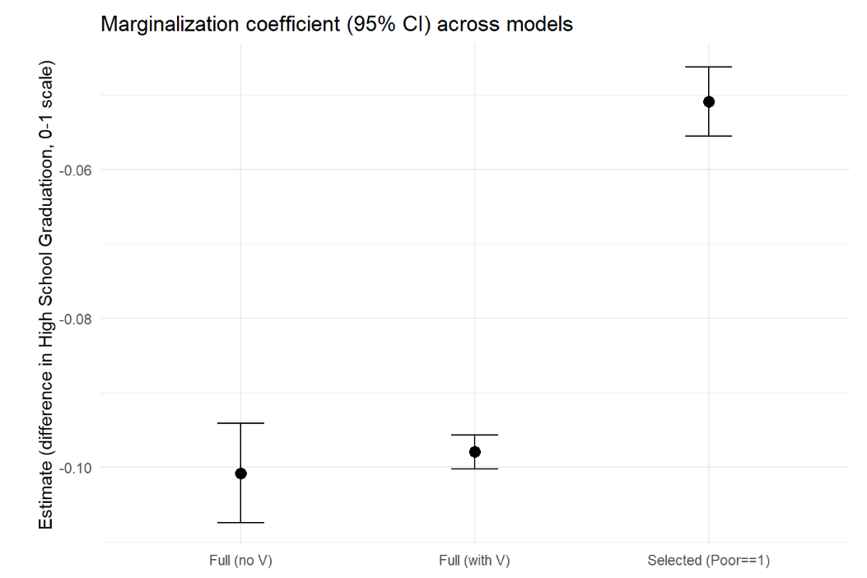
Simulated Data Example
Model 3
To explore the effect of marginalization on likelihood of graduation, we use four variables:
Marginalization
Vulnerabilities
Low-income Neighborhood
High school graduation rate
Data is simulated in three models
All y-axis numbers are negative, reflecting a negative impact in likelihood of graduation
Model 2
Model 1

Slide 10
Simulated Data Example
Model 1: Full data (no vulnerabilities)
Estimated impact of marginalization on likelihood of high school graduation
Controlling for poverty and neighborhood but NOT controlling for other variables (vulnerabilities)
Vulnerabilities not often captured in data
Most realistic, slightly less precise
Avoids collider bias
Effect on high school graduation: -10.1%
Conclusion: Marginalization decreases likelihood of high school graduation by 10.1%
Model 1: -10.1%
Controls for poverty and neighborhood.
Does NOT control for vulnerabilities.
Avoids collider bias.
Most realistic, slightly less precise.
Model 1

Slide 11
Simulated Data Example
Model 2: Full data
Estimated impact of marginalization on likelihood of high school graduation
Controlling for poverty AND controlling for other variables (vulnerabilities, neighborhood)
Increased precision but less realistic
Avoids collider bias
Effect on high school graduation: -9.8%
Conclusion: Marginalization decreases likelihood of high school graduation by 9.8%
Model 2: -9.8%
Controls for poverty, neighborhood, and vulnerabilities.
Avoids collider bias.
Most idealistic, more precise.
Model 2

Slide 12
Simulated Data Example
Model 3
Model 3: Harper’s data
Estimated impact of marginalization on likelihood of high school graduation
Controlling for poverty but NOT controlling for other variables (vulnerabilities, neighborhood)
Collider bias!
Effect on high school graduation: -5.1%
Conclusion: Marginalization decreases likelihood of high school graduation by 5.1%
Biased impact of marginalization on high school graduation, wrongly suggesting a small impact
Model 3: -5.1%
Controls for poverty.
Does NOT control for neighborhood or vulnerabilities.
Collider bias !!!
Under-inflated effect on likelihood of high school graduation.

Slide 13
Estimates of the impact of marginalization on the chance of graduating high school (0-1 scale) for models with and without collider bias
Model 3: -5.1%
Controls for poverty.
Does NOT control for neighborhood or vulnerabilities.
Collider bias !!!
Under-inflated effect on likelihood of high school graduation.
Model 1: -10.1%
Controls for poverty and neighborhood.
Does NOT control for vulnerabilities.
Avoids collider bias.
Most realistic, slightly less precise
Model 2: -9.8%
Controls for poverty, neighborhood, and vulnerabilities.
Avoids collider bias.
Most idealistic, more precise.

Slide 14
Consequences of Ignoring Collider Bias
Marginalization
Low-income Neighborhood
High School Graduation
Vulnerabilities
The example highlights three main points:
1. Marginalization due to race and vulnerabilities (e.g. chronic health conditions in the family) are unrelated overall. Note: our DAG has no arrows directly connecting marginalization and vulnerabilities
Marginalized people tend to live in poor neighborhoods because they’re marginalized
Non-marginalized people tend to live in low-income neighborhoods because of their vulnerabilities (e.g., chronic health conditions)
In other words, marginalized & non-marginalized students tend to live in low-income neighborhoods for different, unrelated reasons
2. If we want to estimate the effects of marginalization on educational outcomes, but we only have information about students living in/attending school in low-income neighborhoods, in effect we’re comparing marginalized students to a subset of non-marginalized students with above-average levels of vulnerability
3. This will underestimate the negative effect of marginalization on likelihood of high school graduation
Notes:
Collider variable = an endogenous variable caused by two other variables
Collider variables have at least two arrows pointing towards them
The two variables that point towards the collider have an association

Slide 15
Consequences of Ignoring Collider Bias
We reach inaccurate conclusions that tend to underestimate the impact of structural problems in society
This can negatively impact decision-making in social investments, funding allocation, policy-making, etc.
It can help perpetuate social biases
A study using administrative police records found no racial differences in police use of force during encounters with civilians (Bui & Cox, 2016)
Another study later proved this conclusion wrong, showing how collider bias was responsible for these biased results (Knox et al., 2020)
Notes:
Collider variable = an endogenous variable caused by two other variables
Collider variables have at least two arrows pointing towards them
The two variables that point towards the collider have an association

Slide 16
What to do about it?
Diagnose with a directed acyclic graph (DAG): before engaging in data analytics, draw your assumptions about what factors influence your variables of interest and target population
Systemic factors (i.e. racism)
Individual-level factors (i.e. (dis)ability status)
Note that using administrative data require us to think hard about whether collider bias might be lurking
Administrative data may be population-level data, such as all students in a school district or all people seeking homeless services. However, it is NOT a random sample of the population at large
Back to our story, Harper, the social worker, only had school data for Amari and Liam’s neighborhood. This data does not include other suburbs more accessible to non-marginalized students, where disparities emerge
Could Harper access other school district data?

Slide 17

What to do about it?
Be transparent about the limitations of research.
Harper's Realization:
I can't conclude that discrimination doesn't matter.
I can only conclude that for this specific neighborhood, high poverty affects everyone’s educational opportunities.
This likely makes the effect of discrimination look smaller than it really is.
I need county-wide school data to see the real pattern.

Slide 18
References
Elwert, F., & Winship, C. (2014). Endogenous Selection Bias: The Problem of Conditioning on a Collider Variable. Annual review of sociology, 40, 31–53. https://doi.org/10.1146/annurev-soc-071913-043455
Hernández-Díaz, S., Schisterman, E. F., & Hernán, M. A. (2006). The birth weight "paradox" uncovered?. American journal of epidemiology, 164(11), 1115–1120. https://doi.org/10.1093/aje/kwj275
Richter, F. G. C., Coulton, C., Urban, A., & Steh, S. (2021). An Integrated Data System Lens Into Evictions and Their Effects. Housing Policy Debate, 31(3–5), 762–784. https://doi.org/10.1080/10511482.2021.1879201
Pearl, J., & Mackenzie, D. (2018). The book of why: The new science of cause and effect. Basic Books.
Knox, D., Lowe, W., & Mummolo, J. (2020). Administrative Records Mask Racially Biased Policing. American Political Science Review, 114(3), 619–637. doi:10.1017/S0003055420000039
Bui, Q., & Cox, A. (2016, July 11). Surprising new evidence shows bias in police use of force but not in shootings. The New York Times. https://www.nytimes.com/2016/07/12/upshot/surprising-new-evidence-shows-bias-in-police-use-of-force-but-not-in-shootings.html
Notes:
Collider variable = an endogenous variable caused by two other variables
Collider variables have at least two arrows pointing towards them
The two variables that point towards the collider have an association

Slide 19
Appendix: More Examples of Collider Bias

Slide 20
Low Birthweight Paradox
Low birthweight is a risk factor for infant mortality (Low Birthweight → Mortality)
Smoking is a risk factor for low birthweight (Smoking → Low Birthweight → Mortality)
Smoking
Low Birthweight
Mortality
However: among infants of low birthweight, infant mortality is lower for infants born to parents who smoke (!)
What!? Why?
One theory in the 1960s was that parental smoking is beneficial to infants who happen to be born with low birthweight… (Pearl & Mackenzie, 2018)
This paradox was not reliably explained until 2006 (Hernandez-Dıaz et al., 2006)
Notes:
https://academic.oup.com/aje/article/164/11/1115/61454?login=true

Slide 21
Collider Bias
The Birthweight Paradox appears because of selection on a collider:
Among infants of low birthweight (collider), infant mortality is lower for infants born to parents who smoke relative to other infants …
Smoking
Low Birthweight
Mortality
Other risk factors
What may cause infants to have low birthweight?
What else contributes to low birthweight?
Notes:
https://academic.oup.com/aje/article/164/11/1115/61454?login=true

Slide 22
Understanding the Low Birthweight Paradox
A non-causal pathway is opened when selecting on low birthweight (collider variable), biasing estimates of the causal effects of smoking on mortality
Smoking → Low Birthweight ← Other risk factors → Mortality
Other risk factors (i.e., congenital diagnoses) also lead to low birthweight and are high risk factors for infant mortality!
Smoking and other risk factors of low birthweight are uncorrelated in the general population but appear negatively correlated in the low birthweight sample
Our low birthweight population is NOT representative of all births, so it is not suitable to study the impact of smoking on infant mortality
Smoking
Low Birthweight
Mortality
Other risk factors
Notes:
https://academic.oup.com/aje/article/164/11/1115/61454?login=true

Slide 23
Low Birthweight Paradox
Without realizing that low birthweight is a collider variable, we may inaccurately assume that parental smoking is protective for infants of low birthweight
When we see low birthweight as a collider variable, we more accurately understand who comprises our low birthweight population
Smoking
Low Birthweight
Mortality
Other risk factors
Notes:
https://academic.oup.com/aje/article/164/11/1115/61454?login=true

Slide 24
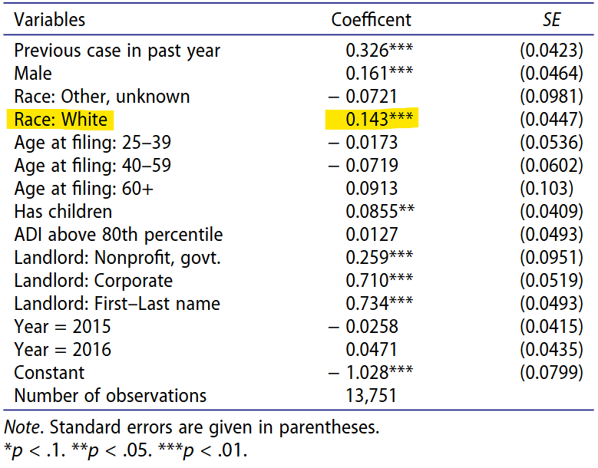
Collider Bias in Eviction Research
In a study in Cleveland, OH, by Richter et al. (2021), a positive association was found between White identity and receiving an eviction order among those who received an eviction filling
Are White individuals more likely to receive an eviction order than individuals of a marginalized race?
Marginalization
Eviction Filing
Eviction Order
Logistic regression model estimation of the likelihood of receiving an eviction order. The data represent eviction case filings in the City of Cleveland, Ohio, 2013–2016, linked to public assistance records. Variables correspond to the head of household associated with the eviction filing.
Notes:
https://www.tandfonline.com/doi/full/10.1080/10511482.2021.1879201#abstract

Slide 25
Collider Bias in Eviction Research
Who makes up the population of people who receive an eviction filing (collider variable)?
Marginalization plays a role in housing instability, but other vulnerabilities unrelated to marginalization, such as health issues may also contribute
Selecting on eviction fillings (using this data in the analysis) cannot help us understand the impact of marginalization on receiving an eviction order
We find that among those who receive an eviction filing, those identified as White are more likely to receive an eviction order, but …
Marginalization
Eviction Filing
Eviction Order
Other unobserved individual-level vulnerabilities
Notes:
https://www.tandfonline.com/doi/full/10.1080/10511482.2021.1879201#abstract

Slide 26
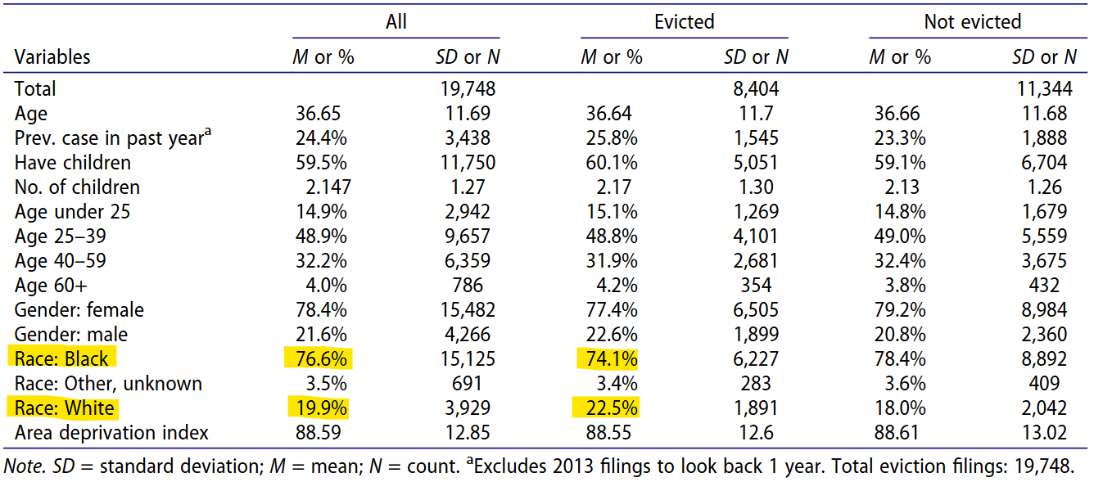
Collider Bias in Eviction Research
… Black head of households are overrepresented in the population of people who receive an eviction filing
Marginalization
Eviction Filing
Eviction Order
Other unobserved individual-level vulnerabilities
Notes:
https://www.tandfonline.com/doi/full/10.1080/10511482.2021.1879201#abstract

Slide 27
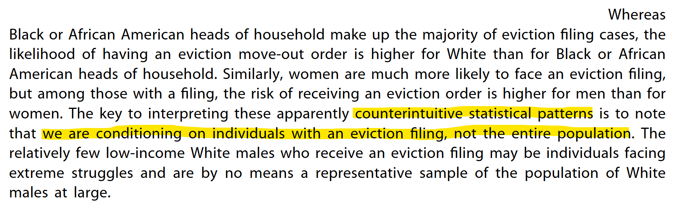
Collider Bias in Eviction Research
Marginalization
Without realizing that eviction filing is a collider variable, we may inaccurately interpret results as White individuals being more likely to receive an eviction order, thus concluding that marginalization does not influence eviction outcomes
Using graphical models can help scrutinize our data and assumptions for colliders and more accurately understand the data and the social system that underlies the data
Eviction Filing
Eviction Order
Other unobserved individual-level vulnerabilities
Note how the authors describe the study findings:
Richter, F. G. C., Coulton, C., Urban, A., & Steh, S. (2021). An Integrated Data System Lens Into Evictions and Their Effects. Housing Policy Debate, 31(3–5), 762–784. https://doi.org/10.1080/10511482.2021.1879201
Notes:
https://www.tandfonline.com/doi/full/10.1080/10511482.2021.1879201#abstract

